Slide 1
Module: WSQ Database Design and Implementation (SF)
Module Project
Plan, Design, and Implement a Database for
eCommerce Portal
Huynh Minh Phu
ASPC-eDUS000447@learning.educlaas.com
Start Date: | 15/12/2023 | End Date: | 15/12/2023
Submission Date: | 15/12/2023 | Presentation Date:

Slide 2
WSQ Database Design and Implementation

Slide 3
Project Objective
• Apply critical thinking skills to analyse requirements and generate a database schema.
• Utilize analytical and problem-solving abilities to develop conceptual, logical, and
physical designs for implementing the database.
• Execute data population strategies to simulate business operations.
• Implement advance data manipulation techniques to generate management reports.
• Employ testing methodologies to ensure the accuracy, reliability, and optimal performance of the database.

Slide 4
2. Scenario
You currently work as a Data Engineer for Brightica design agency, where you design and implement data models for client-centric products. As part of the role, Your manager Mr. Andrew assigned the project to develop an optimal database design to deliver Rich Internet
Application for Boutiqa. Boutiqa is a marketplace for sellers to promote their products and for consumers to purchase with ease. The company wants to have a consumer-centric application
with an enhanced user experience.

Slide 5
3. Requirement
There are 3 types of users:
1. Sellers
2. Consumers
3. Administrator

Slide 6
3. Requirement: Seller
Sellers should be able to perform following functions in the portal:
1. Register in the portal.
2. Update their Profile after logging in.
3. Maintain the product catalog to promote their products.

Slide 7
3. Requirement: Consumer
Consumers should be able to perform following functions in the portal:
1. Register in the portal.
2. Update their Profile after logging in.
3. Search products.
4. Choose products to view the details.
5. Add, edit, and remove items in the shopping cart.

Slide 8
3. Requirement: Administrator
Administrator should be able to perform following functions in the portal:
1. Administer user data.
2. Send bulk email invite to potential clients to register

Slide 9
4. Database Design: Entities
Product: Name, Price, Description, origin, colors
Profile
Portal User
Catalog
Order Item
Cart

Slide 10
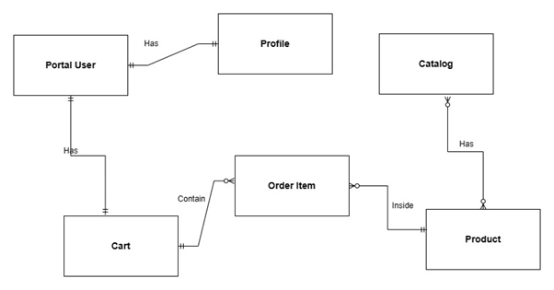
4. Database Design: Conceptual design

Slide 11
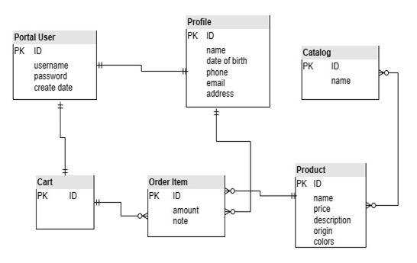
4. Database Design: Logical Design

Slide 12
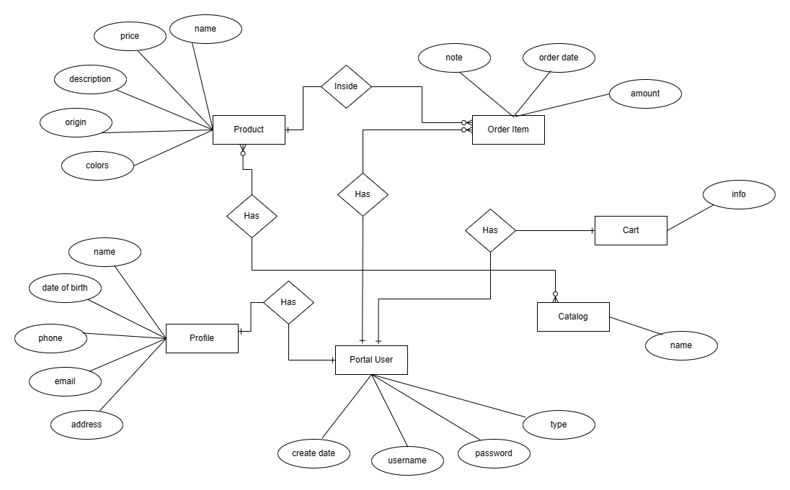
4. Database Design: ER Diagram

Slide 13
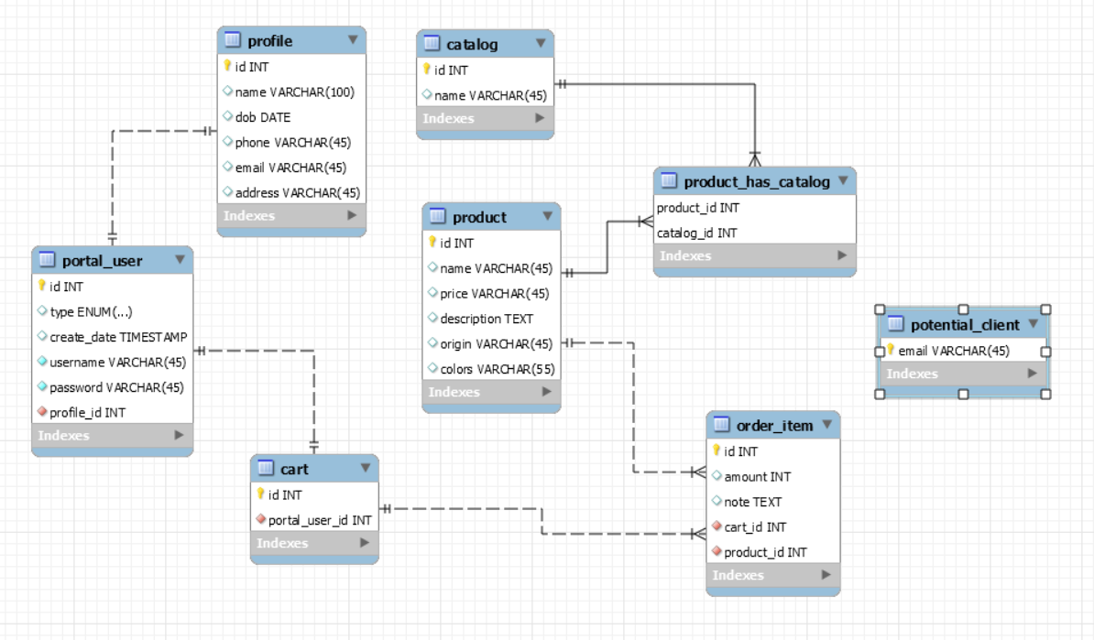
4. Database Design: Physical Design

Slide 14
4. Database Design: Index
profile_email_idx (Table profile)
Helps search users by email more effectively
SELECT * FROM profile where email
profile_phone_idx (Table profile)
Helps search users by phone more effectively
SELECT * FROM profile where phone = ?
profile_dob_idx (Table profile)
Helps search users by date of birth more effectively.
SELECT * FROM profile where dob = ?

Slide 15
4. Database Design: Index
portaluser_username_idx (Table portal_user)
Helps search users by username more effectively when login
SELECT * FROM portal_user where username = ?
product_price_idx (Table product)
Helps search users by price in range more effectively
SELECT * FROM portal_user where price >= ? and price <= ?

Slide 16
4. Database Design: Index
portaluser_username_idx (Table portal_user)
Helps search users by username more effectively when login
SELECT * FROM portal_user where username = ?
product_price_idx (Table product)
Helps search users by price in range more effectively
SELECT * FROM portal_user where price >= ? and price <= ?

Slide 17
4. Implementation: Table cart
CREATE TABLE IF NOT EXISTS `portal`.`cart` (
`id` INT NOT NULL AUTO_INCREMENT,
`portal_user_id` INT NOT NULL,
PRIMARY KEY (`id`),
INDEX `fk_cart_portal_user1_idx` (`portal_user_id` ASC) VISIBLE,
CONSTRAINT `fk_cart_portal_user1`
FOREIGN KEY (`portal_user_id`)
REFERENCES `portal`.`portal_user` (`id`)
ON DELETE NO ACTION
ON UPDATE NO ACTION);

Slide 18
4. Implementation: Table product
CREATE TABLE IF NOT EXISTS `portal`.`product` (
`id` INT NOT NULL AUTO_INCREMENT,
`name` VARCHAR(45) NULL,
`price` VARCHAR(45) NULL,
`description` TEXT NULL,
`origin` VARCHAR(45) NULL,
`colors` VARCHAR(55) NULL,
PRIMARY KEY (`id`));

Slide 19
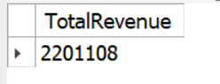
5. Query
Query: Get the total revenue of a product
SQL:
select sum(amount * p.price) as TotalRevenue from order_item inner join product as p
on p.id = order_item.product_id where product_id = '1'
Output:

Slide 20
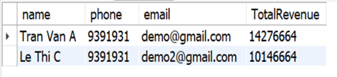
5. Query
Query: Statistic the total sales revenue of a consumer
SQL:
select profile.name, profile.phone, profile.email, sum(amount * p.price) as TotalRevenue from order_item inner join product as p on p.id = order_item.product_id inner join cart on cart.id = order_item.cart_id inner join portal_user on portal_user.id = cart.portal_user_id inner join profile on profile.id = portal_user.profile_id group by cart.portal_user_id order by TotalRevenue desc
Output:

Slide 21
Awesome words

